Slide 1
Speed Mail Application
Aditya Venkatesh Annavarapu
Sai Bhargav Kompalli
Junhyun Kim

Slide 2
Business Problem
Speed Mail, a local business where you can pack and mail parcels, requires an information system that the employees can use.
The system must assist employees in the completion of packaging and mailing parcels for customers through the best carrier service according to the customer’s needs and preferences with additional features that could dramatically increase the viability of the information system.
It should be very helpful to employees in performing their duties effectively and provide a greater level of consistent pricing to customers.
The system should also increase customer satisfaction while increasing productivity and profits.

Slide 3
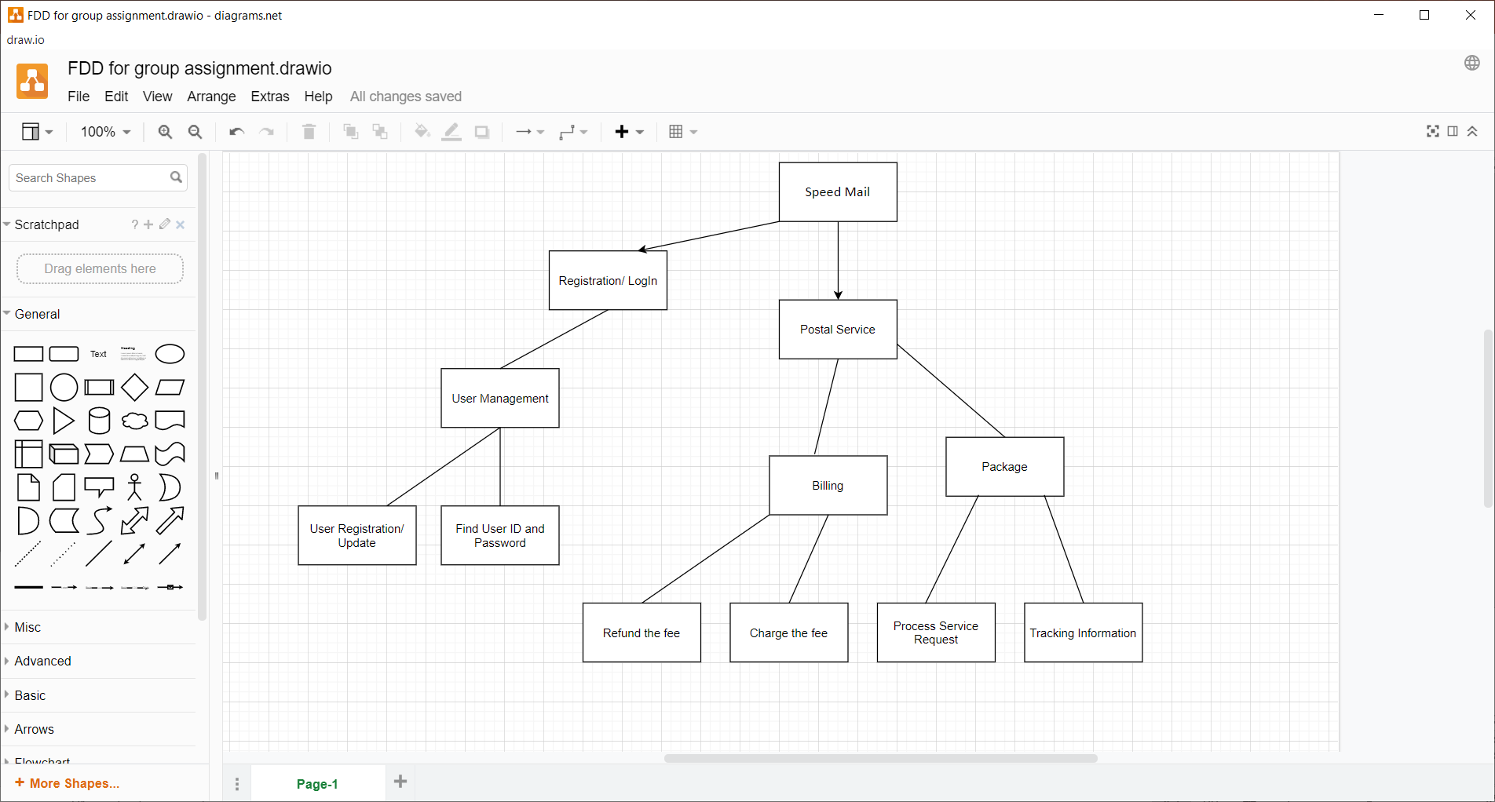
Functional Decomposition Diagram

Slide 4

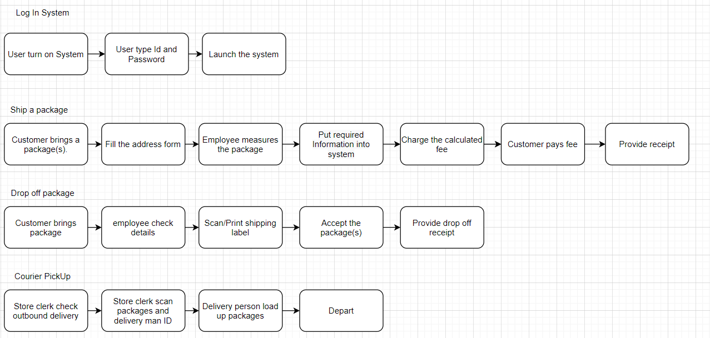
Business Process Modeling

Slide 5
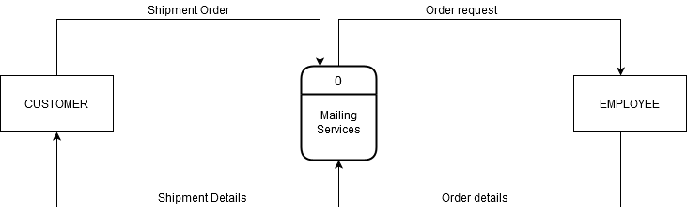
Data Flow Diagram
Context Diagram:

Slide 6
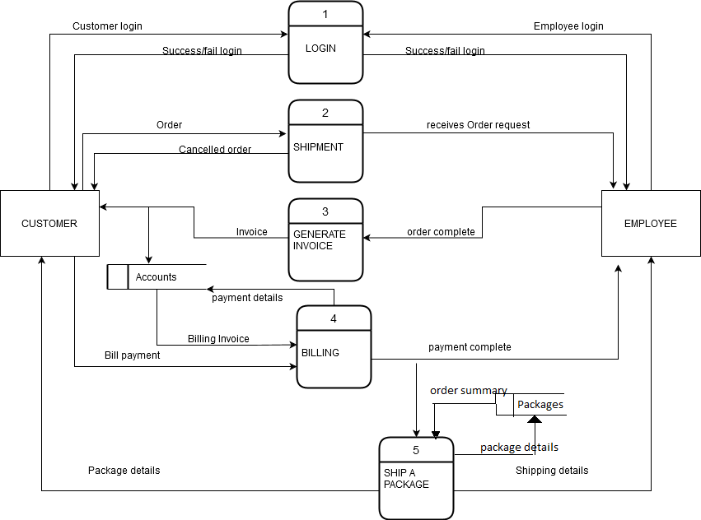
Diagram 0:

Slide 7
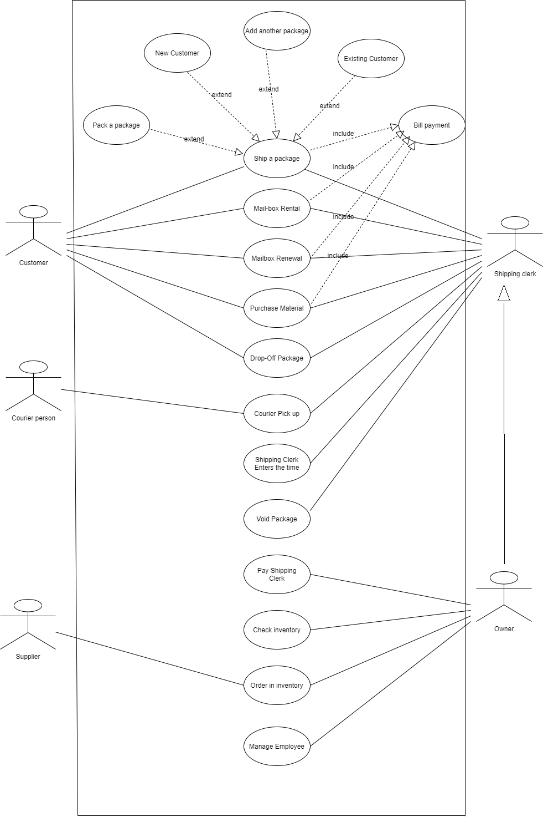
Use Case Diagram

Slide 8
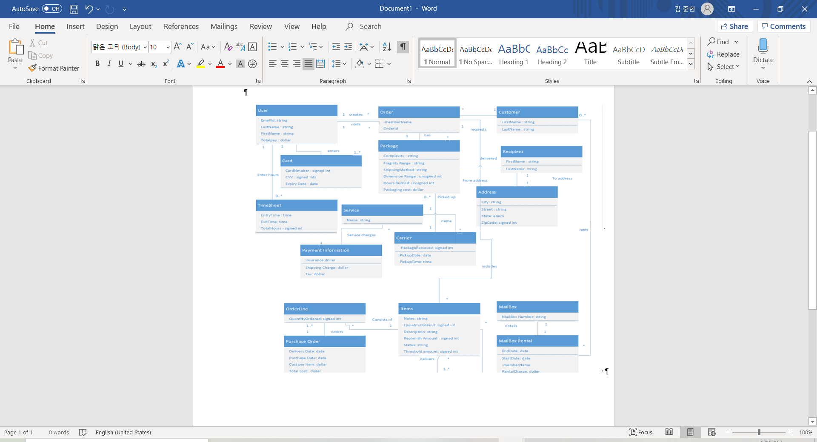
Class Diagram

Slide 9
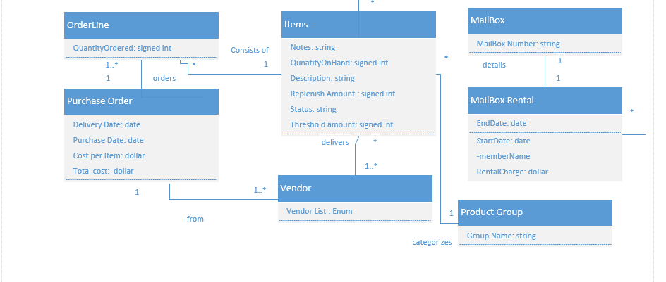
Class Diagram (Cont’d)

Slide 10
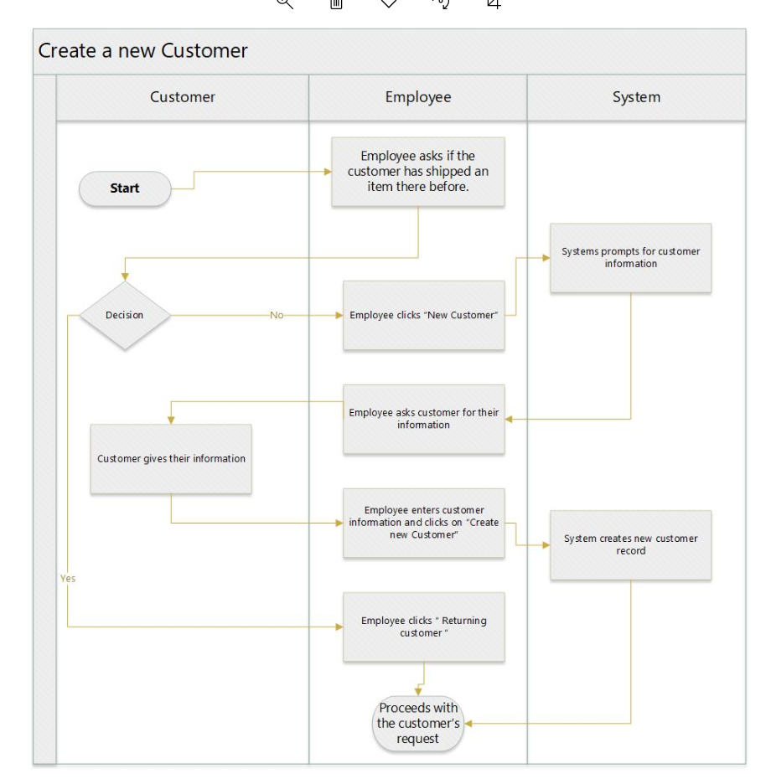
Activity Diagram 1 – Create new customer

Slide 11
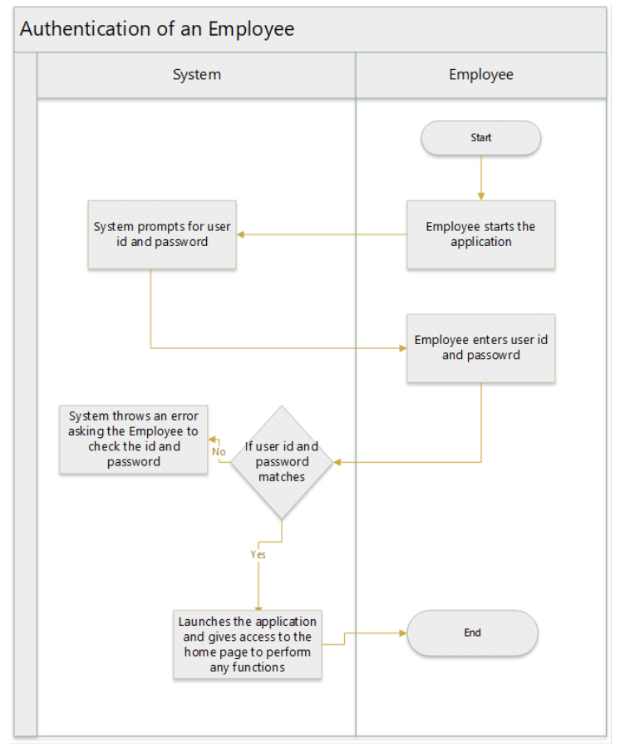
Activity Diagram 2 – Authentication of an Employee

Slide 12
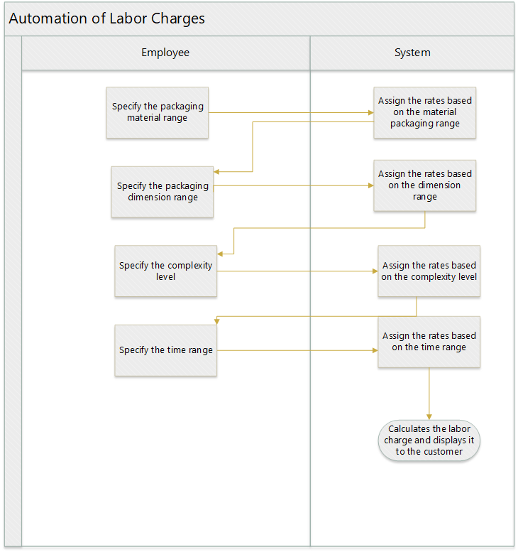
Activity Diagram 3 – Labor Charges

Slide 13
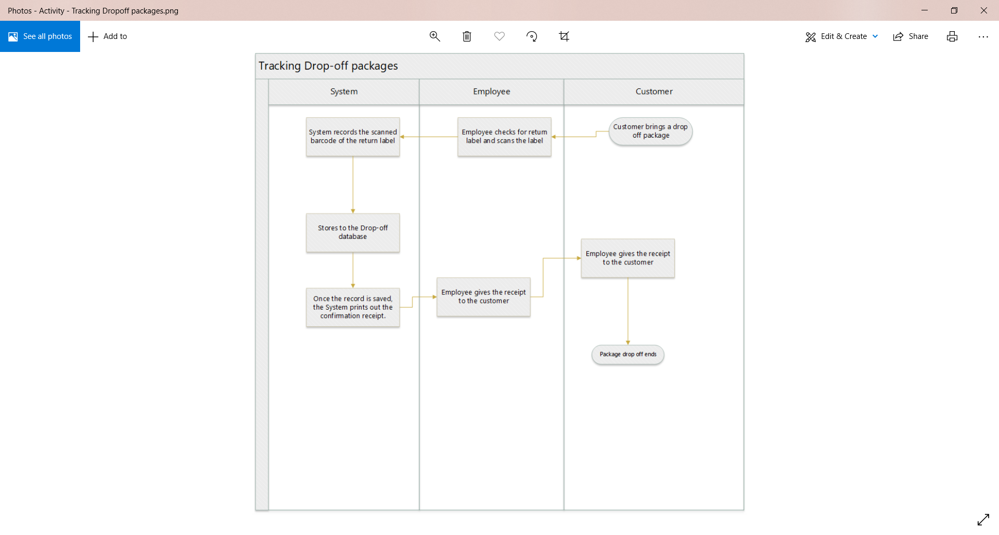
Activity Diagram 4 – Tracking Drop-Off Package

Slide 14
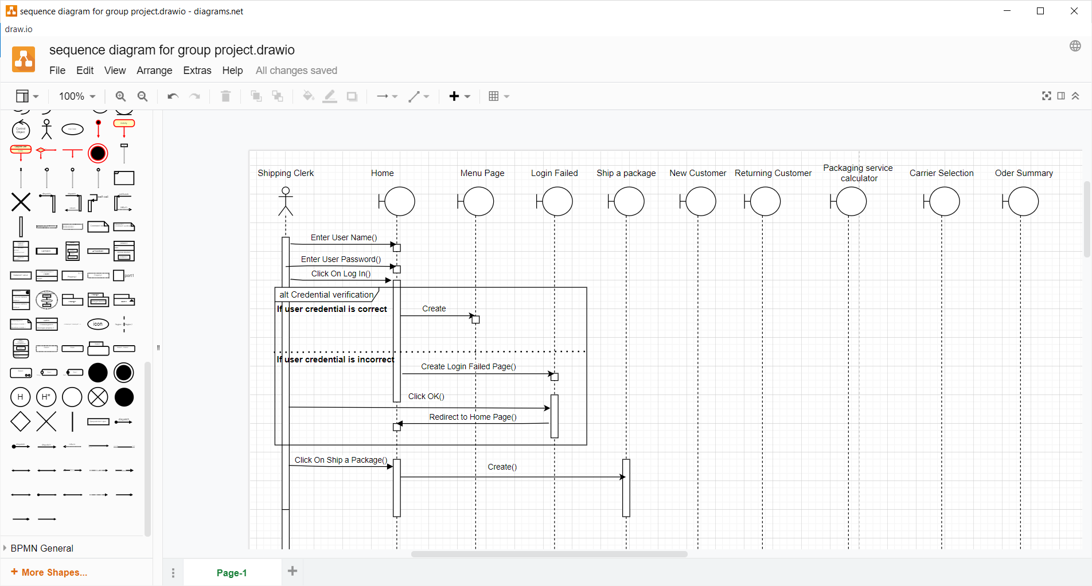
Sequence diagram

Slide 15
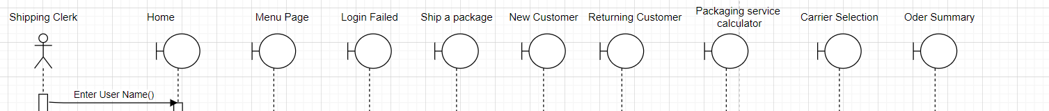
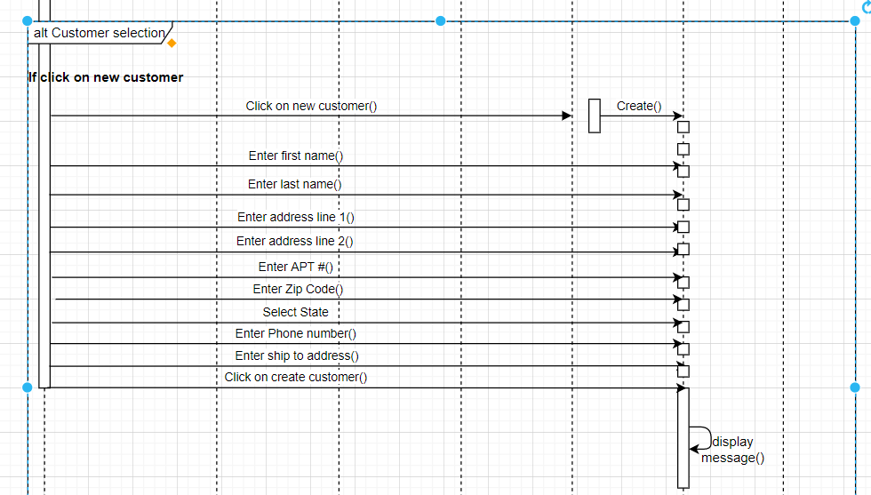

Slide 16
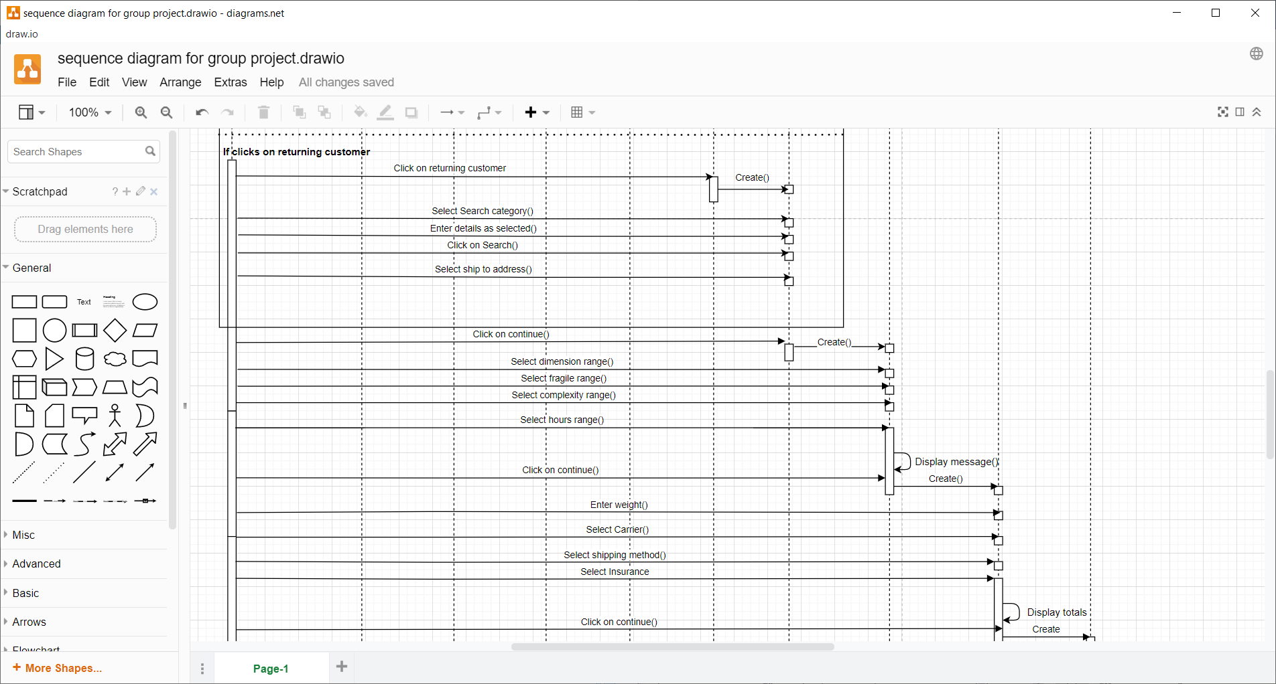

Slide 17
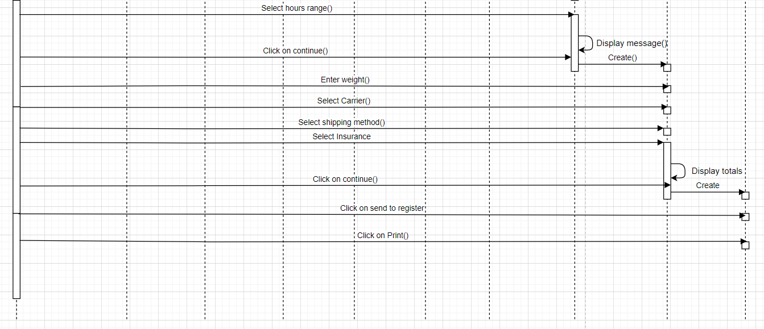

Slide 18
Screen Designs

Slide 19
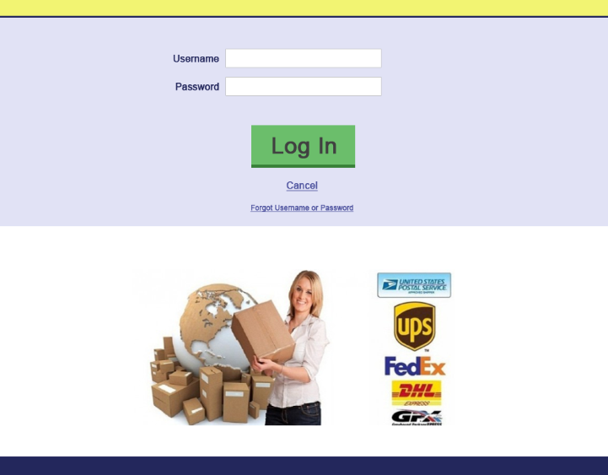
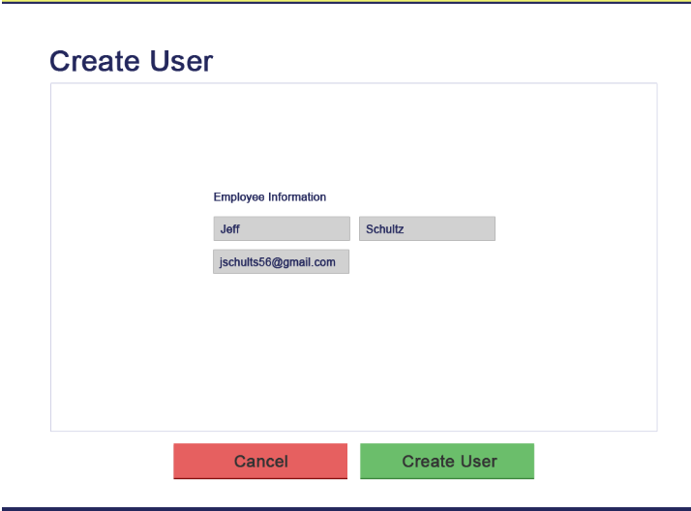

Slide 20
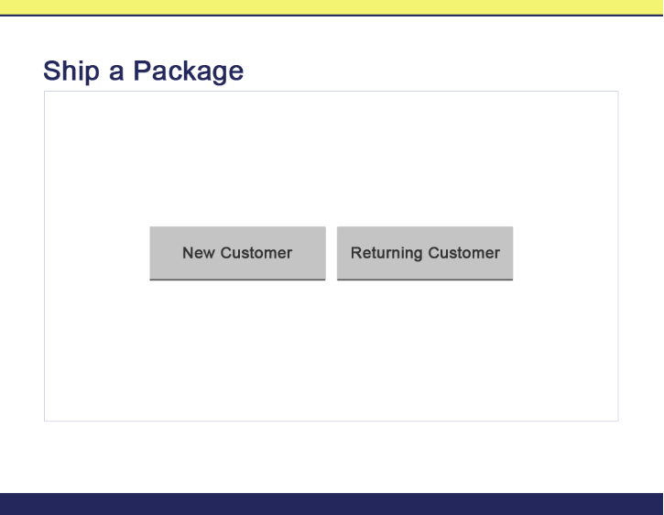
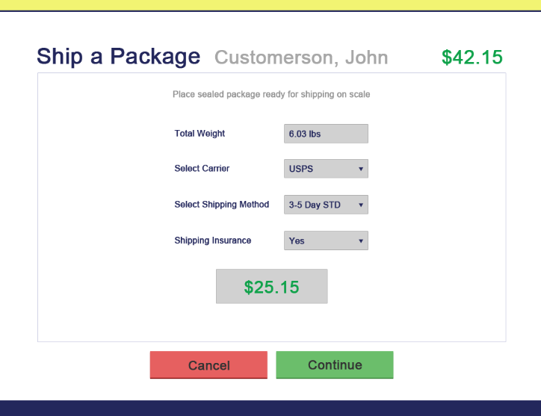

Slide 21
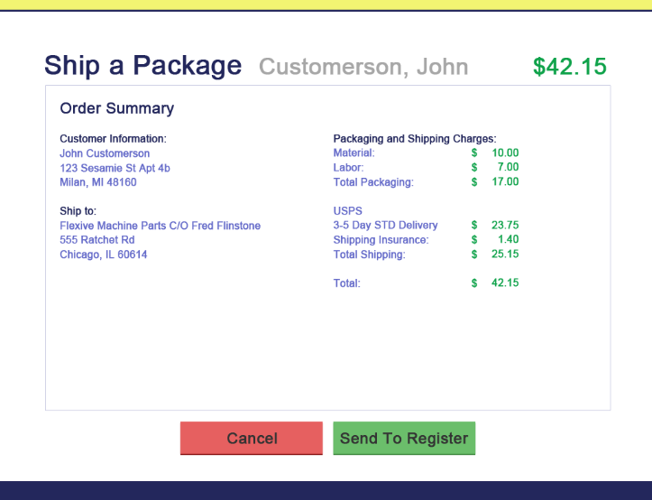
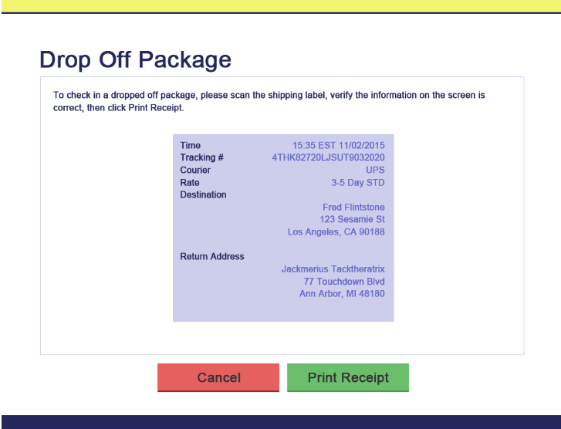

Slide 22
System Capabilities
Provides authentication for the employee so the system can track of the job done by each employee
Maintain customers’ information with all their shipping details and transaction
Avoid creating new customer if there are same data by showing pop up
Provides a list of packing job specifications such as dimensions, weight, fragile in one screen
Track of the drop-off parcels is maintained by scanning their barcode into the new table in the database (Drop-off table)

Slide 23
Expected Business Benefits
Facilitate business operations by helping procedures to register customer and package information
With the auto filling functions, the service will become faster
Provide consistent, accurate pricing for packing parcels based on complexity instead of relying on the employee’s judgment
Save customer information securely and remove redundancy among customer data

Slide 24
Thank You!
Q & A

